Slide 1
Fundamentals of Electrical Engineering
By Anju

Slide 2
Introduction to Electricity
Electricity is a form of energy resulting from the existence or movement of charged particles (such as electrons and protons).
All matter consists of atoms containing three subatomic particles:
• Protons: Positively charged (+e)
• Electrons: Negatively charged (-e)
• Neutrons: Electrically neutral (0)

Slide 3
Free Electrons
Atomic Structure: Atoms consist of a nucleus (protons and neutrons) surrounded by orbiting electrons. The outermost shell is the valence shell.
What are Free Electrons? In conductive materials (like copper, aluminum, and silver), valence electrons are loosely bound to their nuclei. With minimal external energy, they detach and move freely between atoms.
Role in Electricity: These free electrons act as the charge carriers. Without free electrons, a material behaves as an insulator (e.g., rubber, plastic) and cannot conduct electricity.

Slide 4
Electric current
Electricity in Motion
Definition: The rate of flow of electric charge (free electrons) through a cross-section of a conductor per unit of time.
SI Unit: Ampere (A), often abbreviated as "Amp". (1 Ampere = 1 Coulomb/second).
Direction of Current:
  Conventional Current: Historically defined as flowing from Positive (+) to Negative (-).
  Actual Electron Flow: Free electrons actually drift from Negative (-) to Positive (+).

Slide 5
Electric Potential
Electric Potential: The work done in moving a unit positive charge from infinity to a specific point in an electric field.
Potential Difference (Voltage): The difference in electric potential between two distinct points. It represents the electrical "pressure" or driving force that pushes free electrons through a circuit.

Slide 6
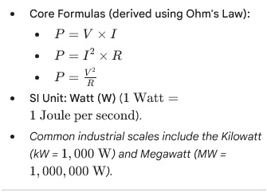
Electrical Power (P)
The Rate of Doing Work
Definition: The rate at which electrical energy is consumed, transferred, or converted into another form of energy (like heat, light, or mechanical motion) by an electric circuit.

Slide 7
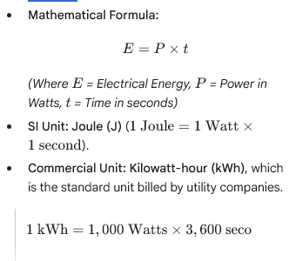
Electrical Energy (E)
Work Done Over Time
Definition: The total capacity to do work, representing the cumulative amount of electrical power consumed over a specific duration.

Slide 8
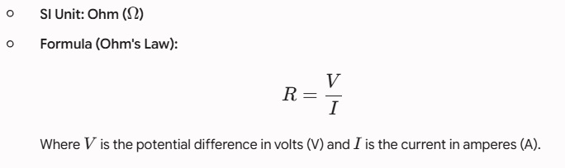
Resistance
Electrical resistance (R) is the property of a material by virtue of which it opposes the flow of electric current through it. When an electric potential difference is applied across a conductor, free electrons move and collide with the atoms/ions of the material, creating opposition to the current flow.

Slide 9
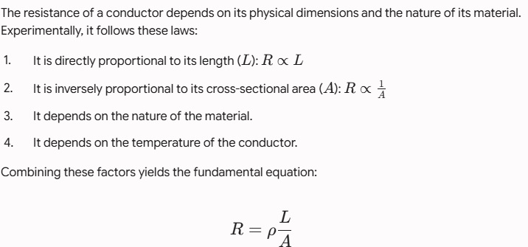
Laws of Resistance

Slide 10
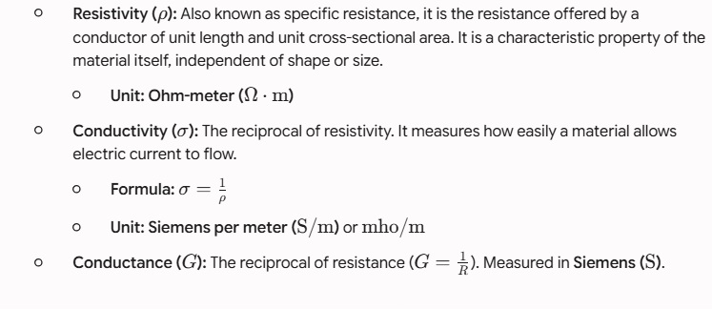
Conductivity and Resistivity

Slide 11
Temperature Effects on Resistance
Effect of Temperature
Materials behave differently when heated:
Pure Metals (Conductors): Resistance increases as temperature rises. The thermal vibration of atoms increases, causing more frequent electron collisions.
Semiconductors and Insulators: Resistance decreases as temperature rises. The thermal energy breaks covalent bonds, releasing more free charge carriers.
Alloys (e.g., Manganin, Constantan): Resistance changes very negligibly with temperature, making them ideal for standard measuring instruments.

Slide 12
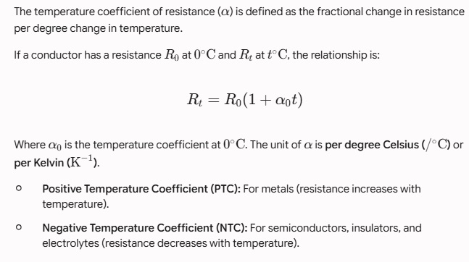
Temperature Coefficient of Resistance (α)

Slide 13
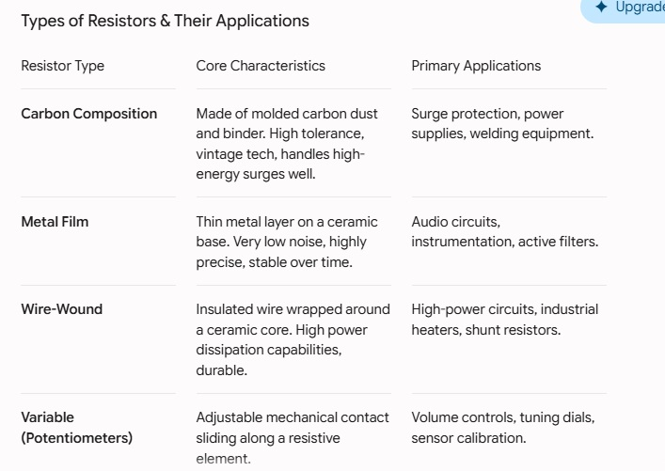
Resistor and its Types

Slide 14
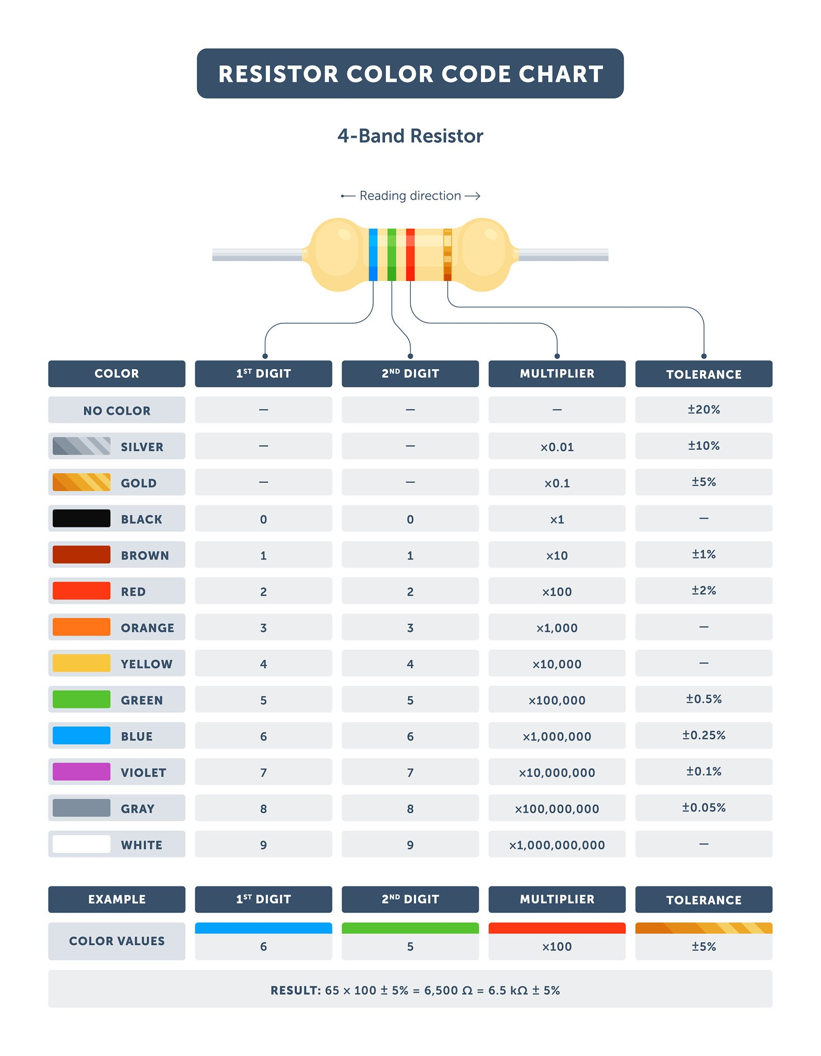
Color Coding of Resistors

Slide 15
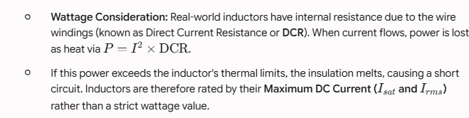
Inductors with Wattage/Power Considerations
An inductor stores energy in a magnetic field when electric current flows through it.

Slide 16
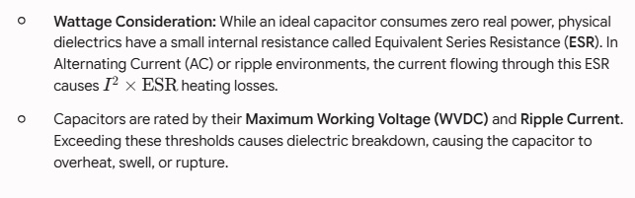
Capacitors with Wattage/Power Considerations
A capacitor stores energy in an electrostatic field between two conductive plates separated by an insulator (dielectric).

Slide 17
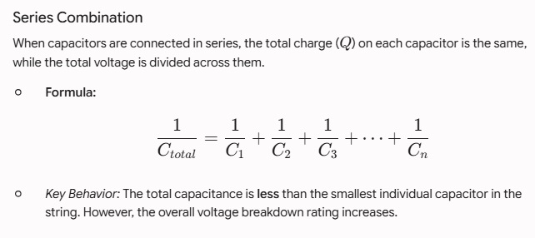
Capacitors in Series

Slide 18
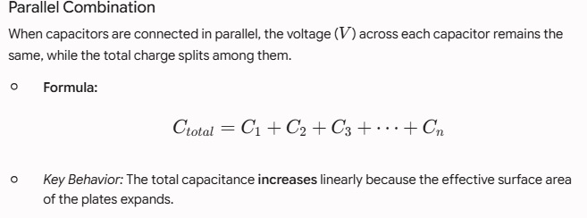
Capacitors in Parallel

Slide 19
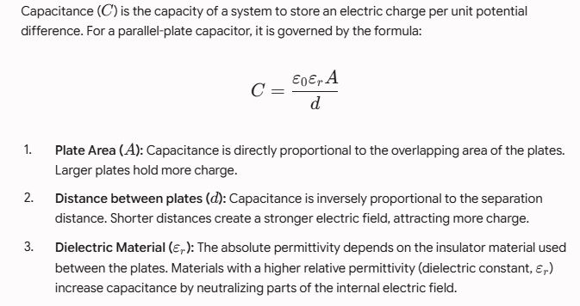
Factors Affecting Capacitance

Slide 20
Ohm’s Law
Ohm's law states that the current flowing through a conductor is directly proportional to the voltage across its ends, expressed as V = I x R), provided the temperature remains constant.
V = I × R
Current is directly proportional to voltage.
Current is inversely proportional to resistance.
Valid for constant temperature conductors.

Slide 21
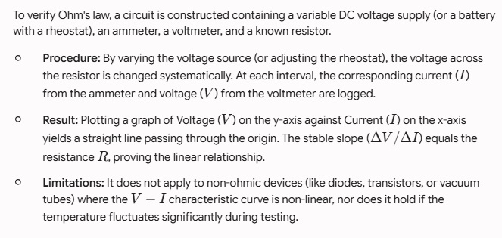
Experimental Verification

Slide 22
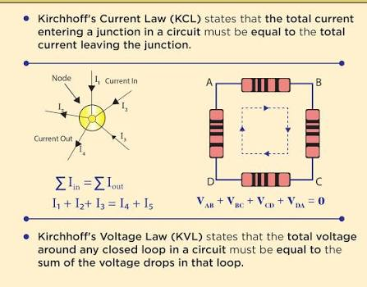
Kirchhoff’s law

Slide 23
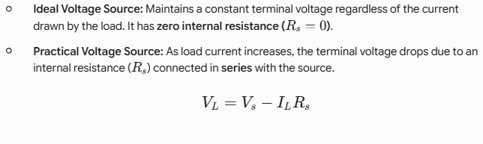
Voltage Sources

Slide 24
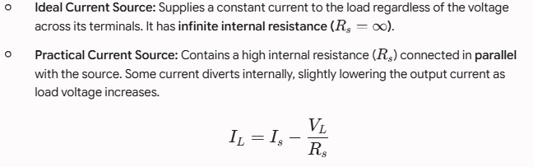
Current Sources

Slide 25
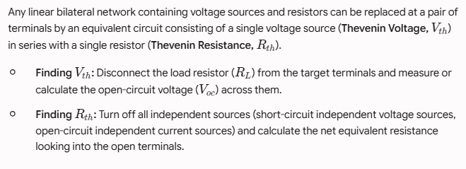
Thevenin's Theorem

Slide 26
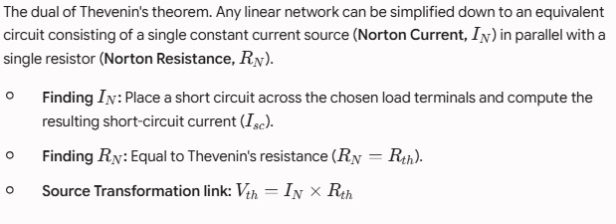
Norton's Theorem

Slide 27
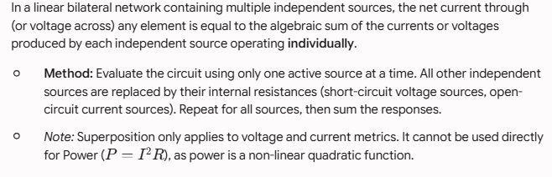
Superposition Theorem

Slide 28
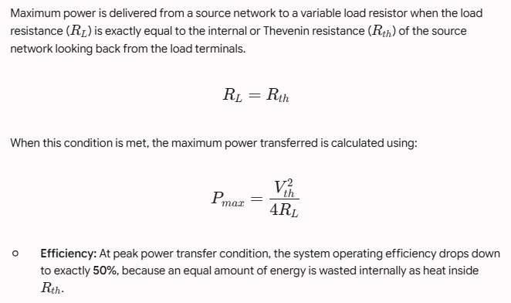
Maximum Power Transfer Theorem

Slide 29

Basic Definitions & Waveform Properties
An Alternating Current (AC) is an electric current that periodically reverses its direction and changes its magnitude continuously with time, unlike Direct Current (DC) which flows in a single direction.
Cycle: One complete set of positive and negative values of an alternating quantity is called a cycle. One cycle consists of one positive alternation and one negative alternation.
Time Period (T): The time taken by an alternating quantity to complete one full cycle. It is measured in seconds (s).
Frequency (f): The number of cycles completed per second by an alternating quantity. It is measured in Hertz (Hz).
Relationship: f =$1/T$
Amplitude (Maximum / Peak Value - Vm or Im): The maximum value (either positive or negative) attained by an alternating quantity during one cycle.

Slide 30
AC Waveform
Because AC constantly changes, we use different metrics to quantify it at any given moment or over time:
Instantaneous Value (v or i): The value of an alternating quantity at any specific instant of time. For a sine wave, it is represented as: v(t) = Vm sin(wt) (where w 2 f is the angular frequency).
Average Value (Varg or Iavg): The arithmetic average of all the instantaneous values over a half-cycle (since the average over a full symmetrical cycle is zero).
For a sinusoidal wave:
Vavg = 2/ π Vm ≈ 0.637Vm
Root Mean Square (R.M.S.) Value (Vrms or Irms): Also known as the effective value. It is the value of AC that produces the same amount of heat in a given resistor as a DC current would over the same time. This is the value read by standard AC voltmeters and ammeters.

Slide 31
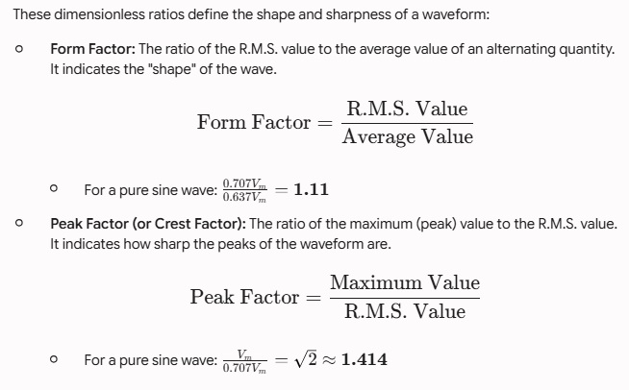
Waveform Factors

Slide 32
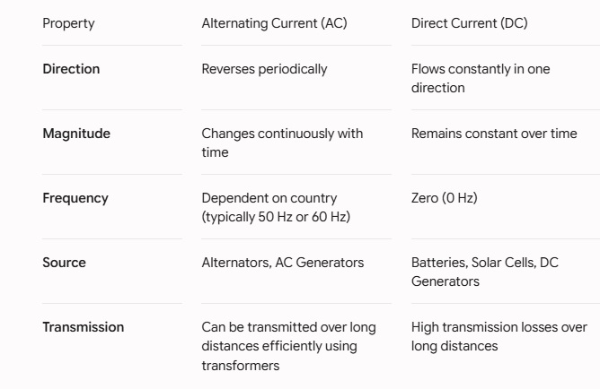
Differences between AC & DC

Slide 33
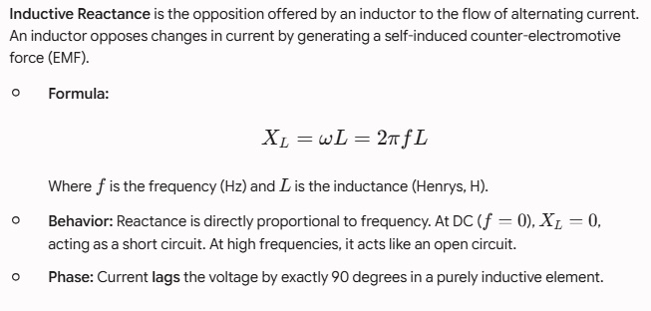
Inductive Reactance (XL)

Slide 34
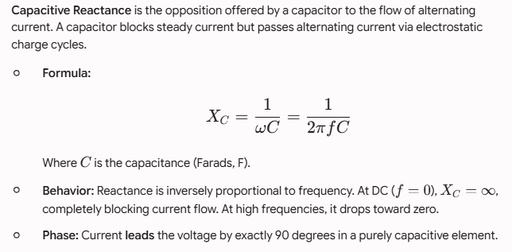
Capacitive Reactance (XC)

Slide 35
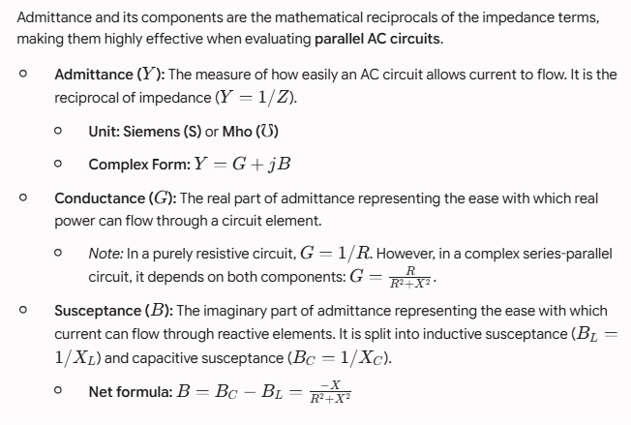
Conductance, Susceptance, and Admittance

Slide 36
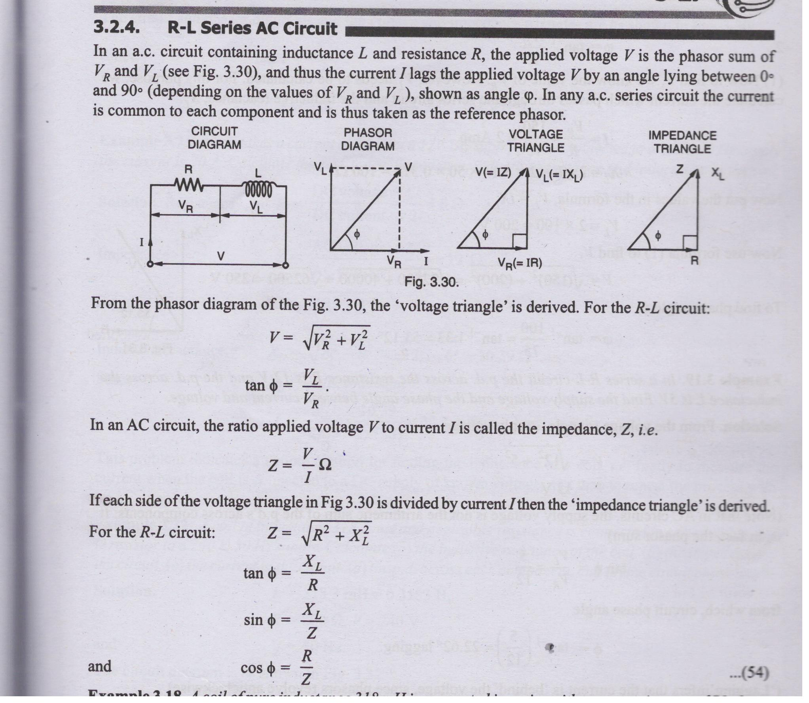
R-L Series AC Circuit

Slide 37
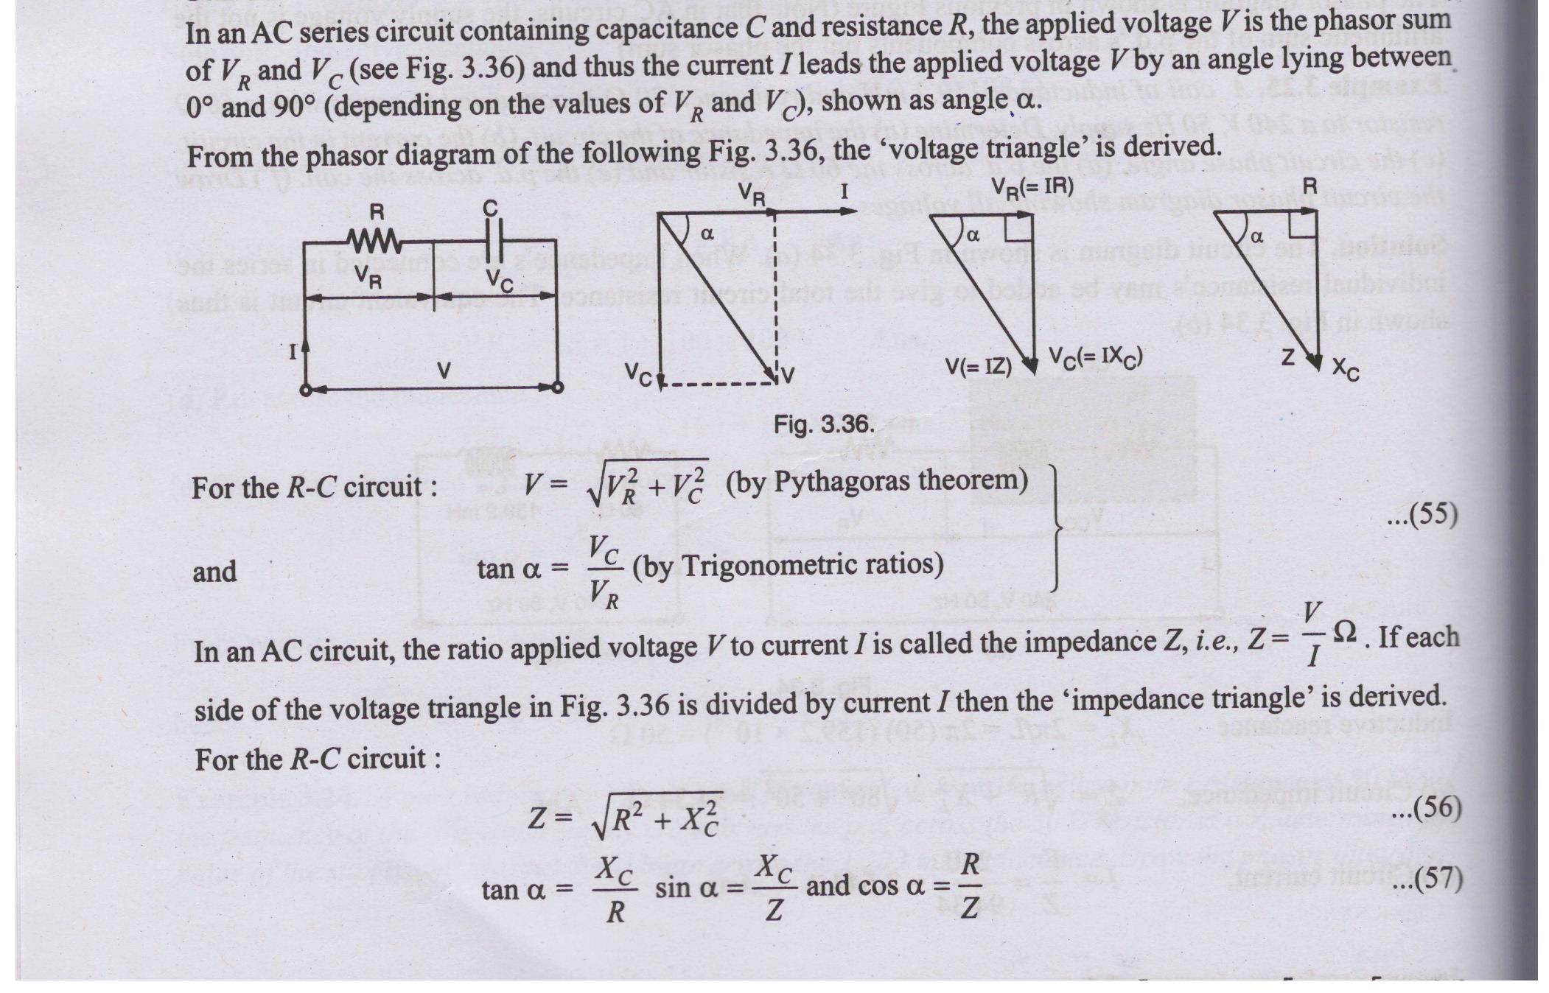
R-C Series AC Circuit

Slide 38
Series RLC Circuit
A Series RLC Circuit is an electrical circuit consisting of a resistor (R), an inductor (L), and a capacitor (C) all connected together in series to an alternating voltage source. Because these components are in series, they will have the same instantaneous current i(t) flowing through them.

Slide 39
Active Power
Active Power (Real / True Power) - P Definition: The actual power consumed or dissipated to perform useful work (e.g., heat, motion, light).
Formula: P = VI cosφ
Unit: Watts (W), Kilowatts (kW)
Significance: Represents actual energy conversion per unit time. Electricity meters measure kilowatt-hours (kWh), which is integrated active power.

Slide 40
Reactive Power
Reactive Power - Q
Definition: The power continuously oscillating between the supply source and the reactive elements (L and C) to sustain electromagnetic and electrostatic fields.
Formula: Q = VI sinφ
Unit: Volt-Amperes Reactive (VAR), kVAR
Significance: Although Q does zero real work, it is essential for creating the magnetic fields required by inductive machinery (motors, transformers, generators). However, excessive reactive power increases total current flow, causing higher line losses (I²R).

Slide 41
Apparent Power
Apparent Power - S
Definition: The total power delivered by the source to the circuit, representing the vector sum of active and reactive power.
Formula: S = VI =
Unit: Volt-Amperes (VA), Kilovolt-Amperes (kVA)
Significance: Determines the total rating capacity of electrical equipment (transformers, generators, cables) regardless of the load's power factor.

Slide 42
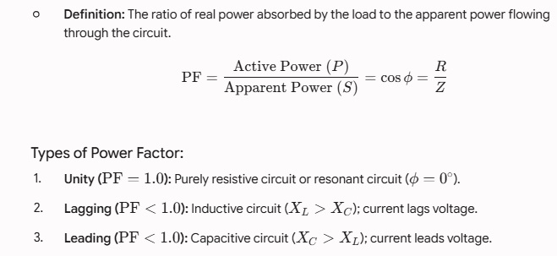
Power Factor (PF)

Slide 43
Electromagnetic Field
Electromagnetic Field Produced by Current Flow
When an electric current (I) flows through a conductor, it generates a magnetic field in the surrounding space (Oersted's Law).
Direction: Determined by the Right-Hand Thumb Rule (if the thumb points in the direction of current, the curled fingers indicate the direction of magnetic field lines).
Shape: Concentric circular field lines around a straight wire, or concentrated parallel lines inside a solenoid/coil.
Fundamentals of Magnetic Circuits
A magnetic circuit is a closed path through which magnetic flux flows.

Slide 44
Cont.
Magnetomotive Force (MMF): The force or pressure that drives magnetic flux through a magnetic circuit. It is created by electric current passing through a coil of wire.
Formula: MMF=N.I (where N is the number of turns and I is current).
Unit: Ampere-turns (AT).
Magnetic Flux (Ф): The total quantity of magnetic field lines passing through a given surface. Unit: Weber (Wb).

Slide 45

Cont.
Reluctance (S or R): The opposition offered by a material or medium to the establishment of magnetic flux.
Formula:
(where l = length of path, A = cross-sectional area, μ = absolute permeability).
Unit: AT/Wb or H-1.

Slide 46
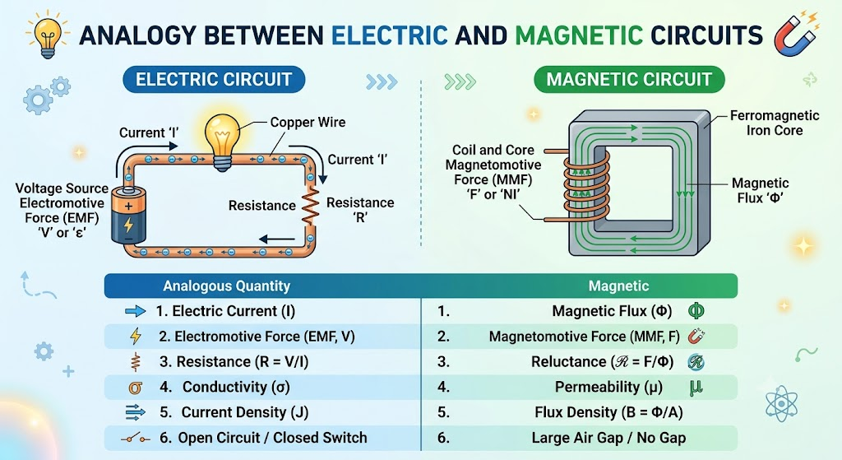
Analogy between electric and magnetic circuit

Slide 47
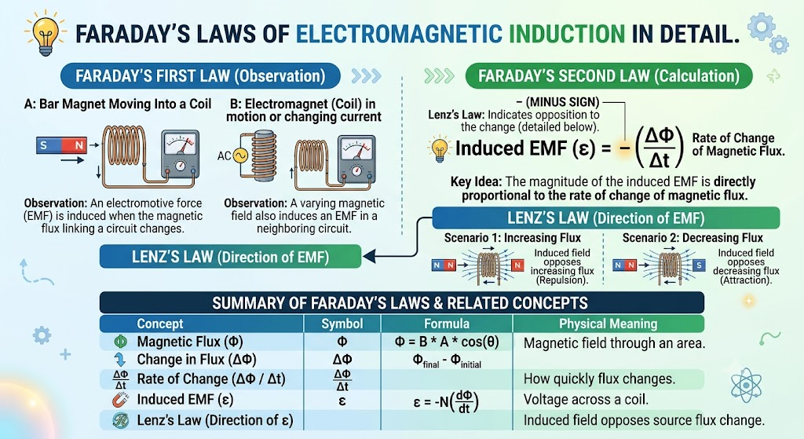
Faraday’s laws of electro-magnetic induction

Slide 48
The Principle of Self-Induction
Self-induction is the phenomenon where a changing current in a coil induces an electromotive force (EMF) within itself. This induced EMF always acts to oppose the change in current that created it, adhering to Lenz's Law.

Slide 49
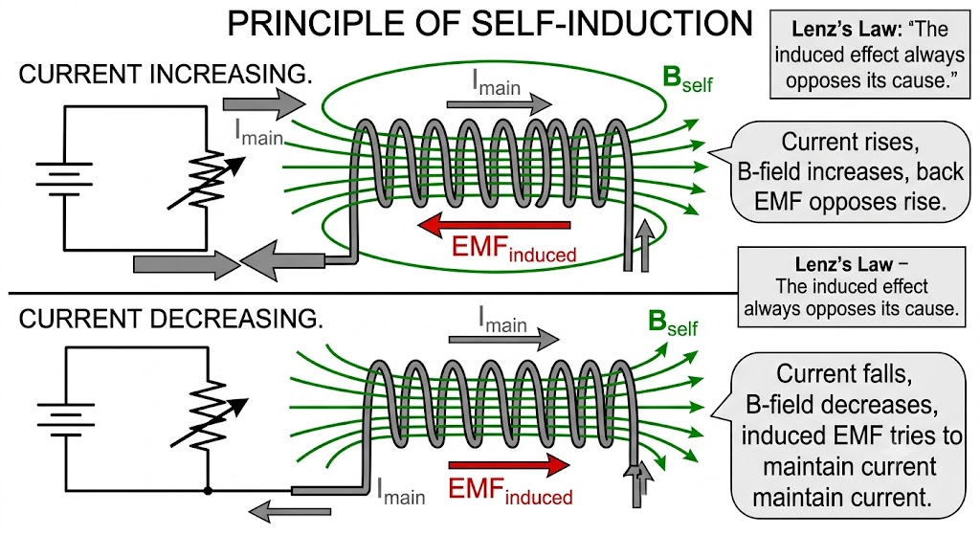
Cont.

Slide 50
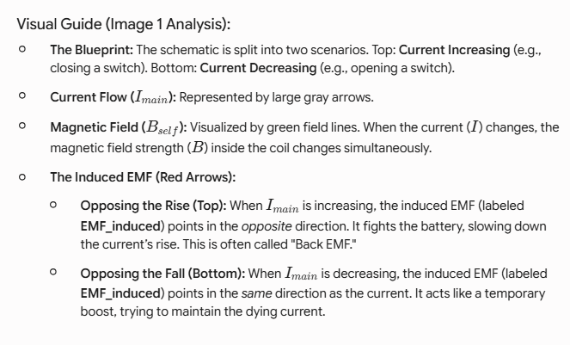
Cont.

Slide 51
The Principle of Mutual Induction
Mutual induction is the phenomenon where a changing current in one coil (the primary) induces an electromotive force (EMF) across a second, adjacent coil (the secondary). This is achieved through the coupling of their magnetic fields; the two coils are electrically isolated.

Slide 52
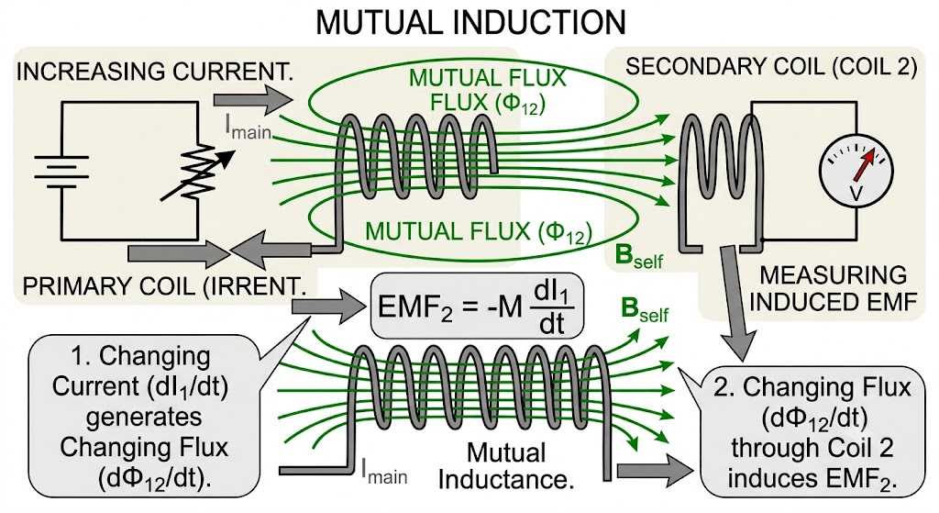
Cont.

Slide 53
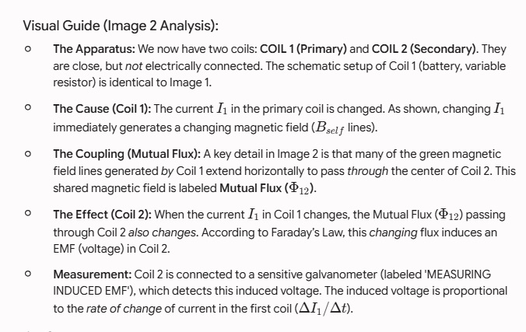
Cont.

Slide 54
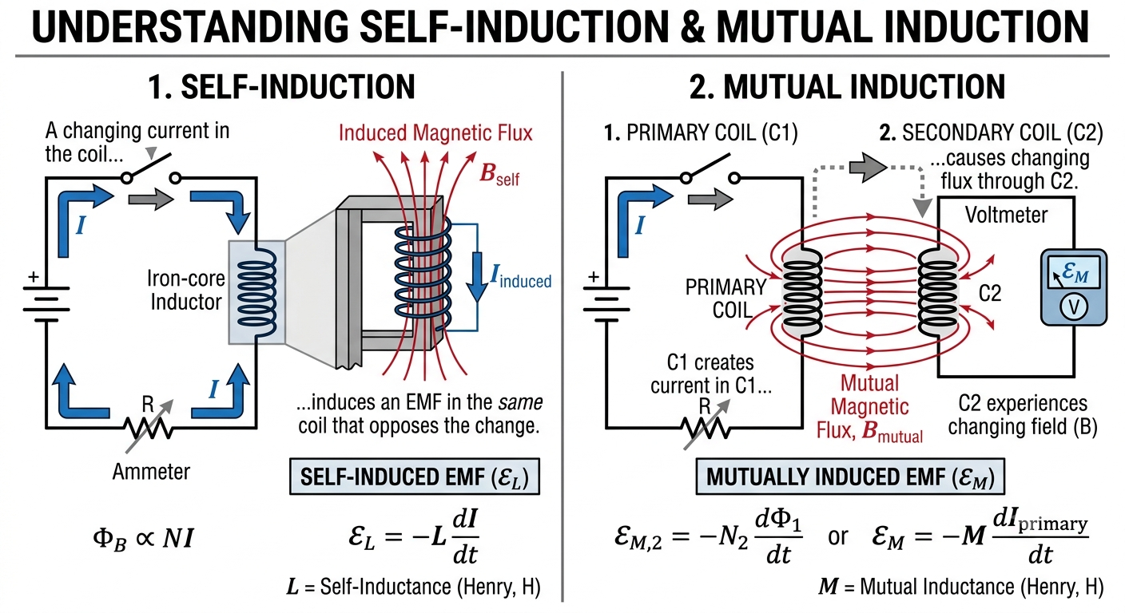
Self and mutually induced emf

Slide 55
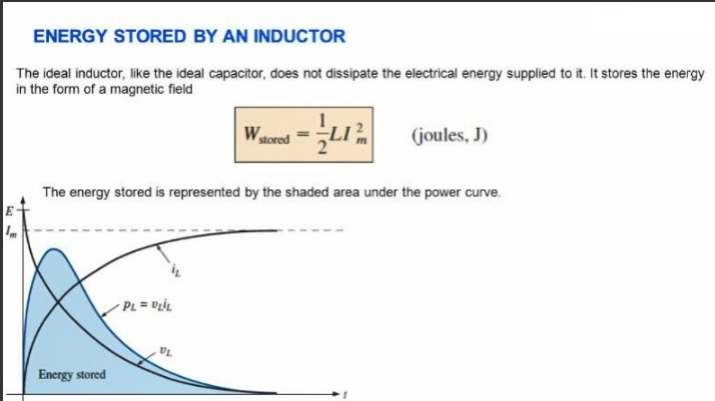
Energy stored in an inductor

Slide 56
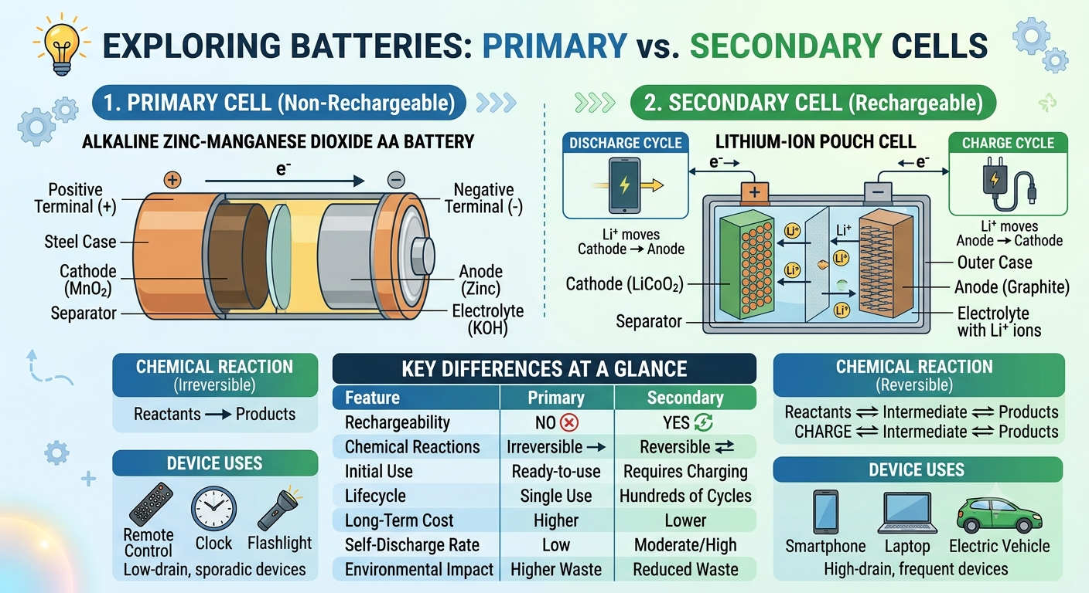
Batteries

Slide 57
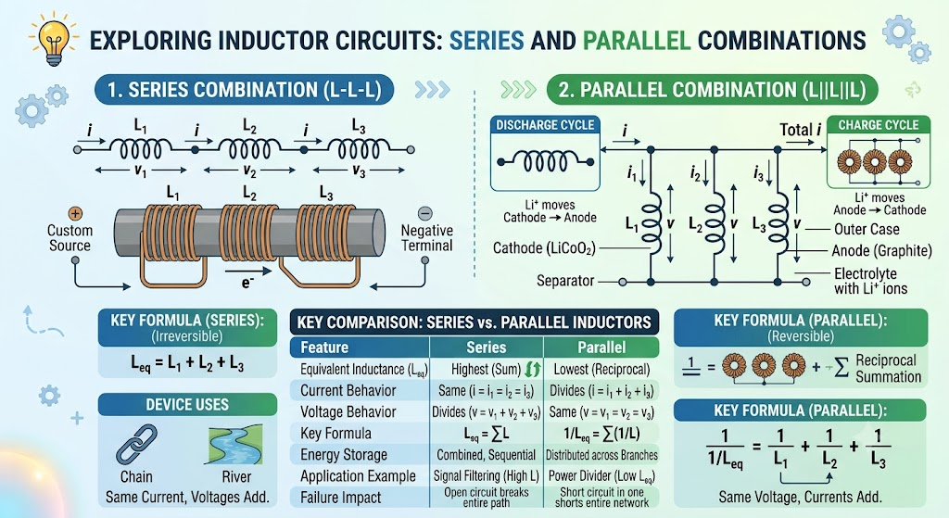
Series and Parallel combination of inductors

Slide 58
Construction of a Lead-Acid Battery
A standard 12V Lead-Acid Battery consists of 6 individual 2V cells connected in series inside a single container. Each cell generates approximately 2.1 V when fully charged, bringing the total terminal voltage to around 12.6V.

Slide 59
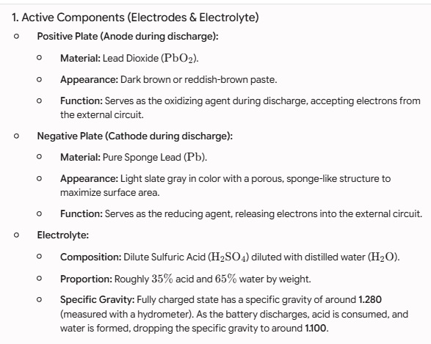
Cont.

Slide 60
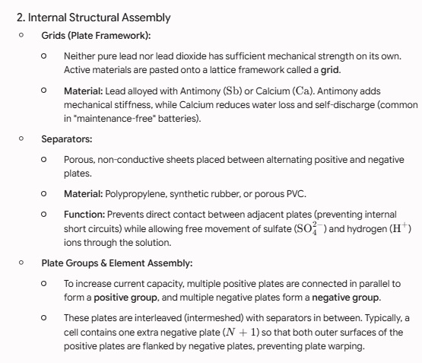
Cont.

Slide 61
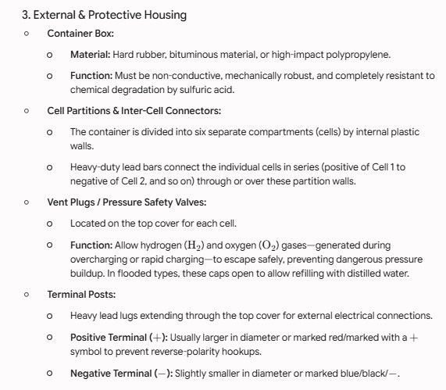
Cont.

Slide 62
Working Principle of Lead-Acid Battery
A lead-acid battery is a type of rechargeable battery that utilizes chemical reactions to store and release electrical energy. Its working principle is based on the reversible chemical reaction between lead and sulfuric acid.
Inside a fully charged lead-acid battery, there are two electrodes: a positive electrode (anode) made of lead dioxide (PbO2) and a negative electrode (cathode) made of sponge lead (Pb). Both electrodes are immersed in an electrolyte solution of sulfuric acid (H2SO4).

Slide 63
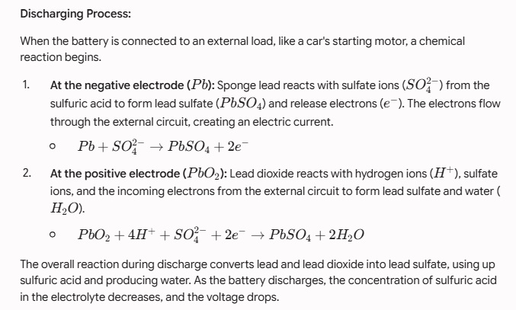
Cont.

Slide 64
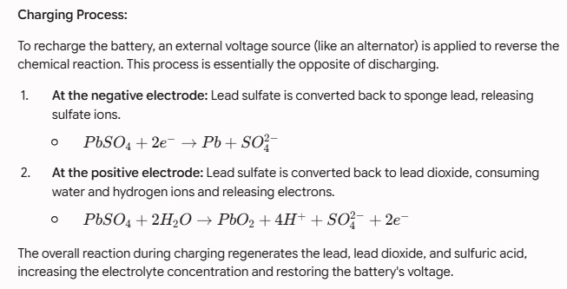
Cont.

Slide 65
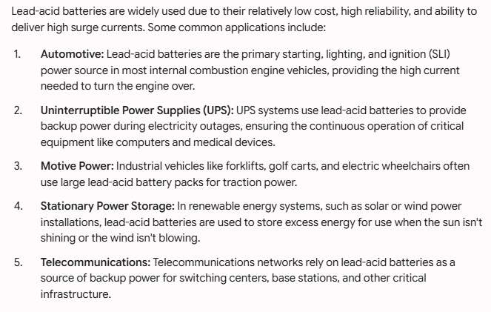
Applications of Lead-Acid Batteries

Slide 66
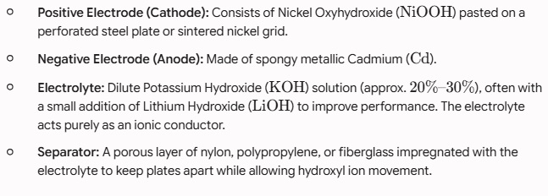
Construction of Nickel-Cadmium

Slide 67
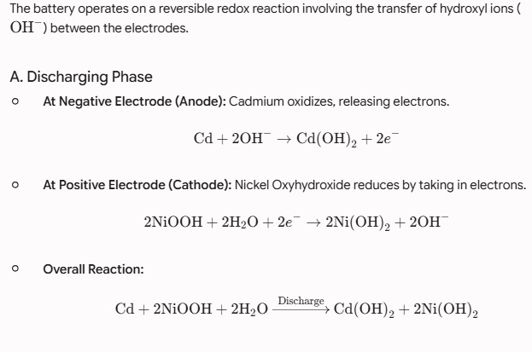
Working Principle

Slide 68
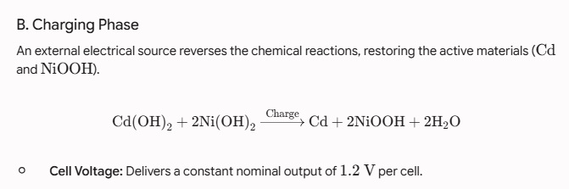
Cont.

Slide 69
Applications
Due to their low internal resistance, ability to deliver high surge currents, long cycle life, and reliable operation across extreme temperature ranges, Ni-Cd batteries are widely used in:
Aviation & Aerospace: Aircraft engine starting, onboard emergency backup power systems, and satellite power supplies.
Emergency & Backup Systems: Emergency lighting fixtures, medical equipment power backups, and uninterrupted power supply (UPS) units.
Industrial & Electrical Utilities: Railway signaling, switchgear actuation, substations, and telecommunications towers.
Portable Power Tools & Devices: High-drain corded/cordless power tools, two-way radios, and commercial photography equipment.
Consumer Electronics: Standby power for alarm systems, cordless phones, and solar-powered outdoor garden lights.

Slide 70
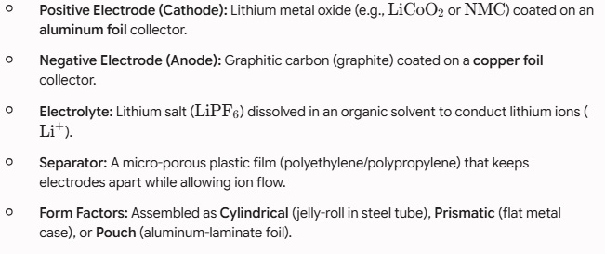
Construction of a Lithium-Ion (Li-Ion) Battery

Slide 71
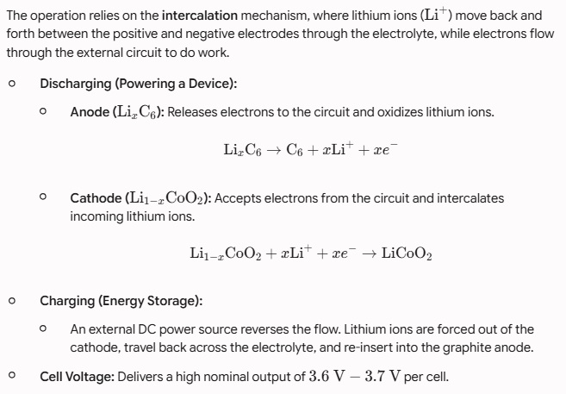
Working Principle

Slide 72
Applications
Due to their high energy density, lightweight construction, low self-discharge, and high operating voltage, Lithium-Ion batteries are used across a wide range of industries:
Portable Consumer Electronics: Powers smartphones, laptops, tablets, smartwatches, digital cameras, and Bluetooth headphones.
Electric Vehicles (EVs): Serves as the primary power source for electric cars, e-bikes, electric scooters, and hybrid buses.
Energy Storage Systems (ESS): Used for grid-scale energy storage and residential solar battery systems (e.g., storing solar power for nighttime use).
Cordless Power Tools: Drives high-drain portable equipment like electric drills, saws, lawnmowers, and vacuum cleaners.
Aerospace & Defense: Used in satellites, military drones, space rovers, and modern commercial aircraft sub-systems.
Medical Devices: Powers portable oxygen concentrators, pacemakers, surgical tools, and digital monitoring equipment

Slide 73

Series and parallel connections of batteries.

Slide 74
Disposal of batteries
The disposal of batteries requires careful handling because they contain hazardous chemicals, heavy metals (such as lead, cadmium, mercury, and lithium), and residual electrical energy that can pose severe environmental, health, and fire hazards if thrown into regular trash.

Slide 75
Environmental & Safety Hazards of Improper Disposal
Chemical Leaching: Toxic heavy metals (lead, cadmium, mercury) and strong acids/bases can leak from degrading casings in landfills, contaminating soil and groundwater.
Fire Hazards: Lithium-ion batteries can easily catch fire or explode if punctured, crushed, or exposed to heat in trash compactors and garbage trucks.
Toxic Air Emissions: Incinerating batteries releases hazardous airborne toxins into the atmosphere.

Slide 76

Cont.

Slide 77

Maintenance of Free Batteries

